Slide 1




Multi-Intent Classification in Chatbots Review-3
Project Guide
Dr. E. Sivasankar
Project Team Members
106118058 Asif
106118085 Sampurn
106118116 Supria

Slide 2
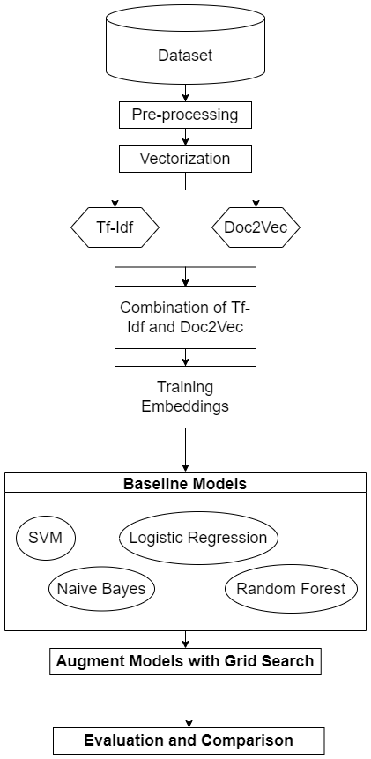
Block Diagram

Slide 3
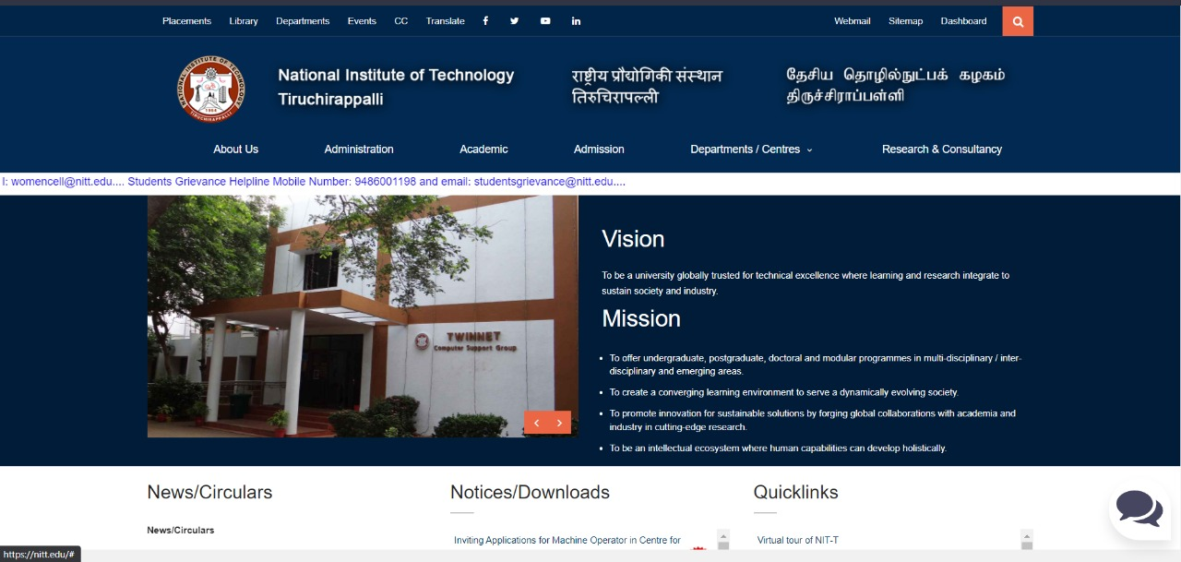
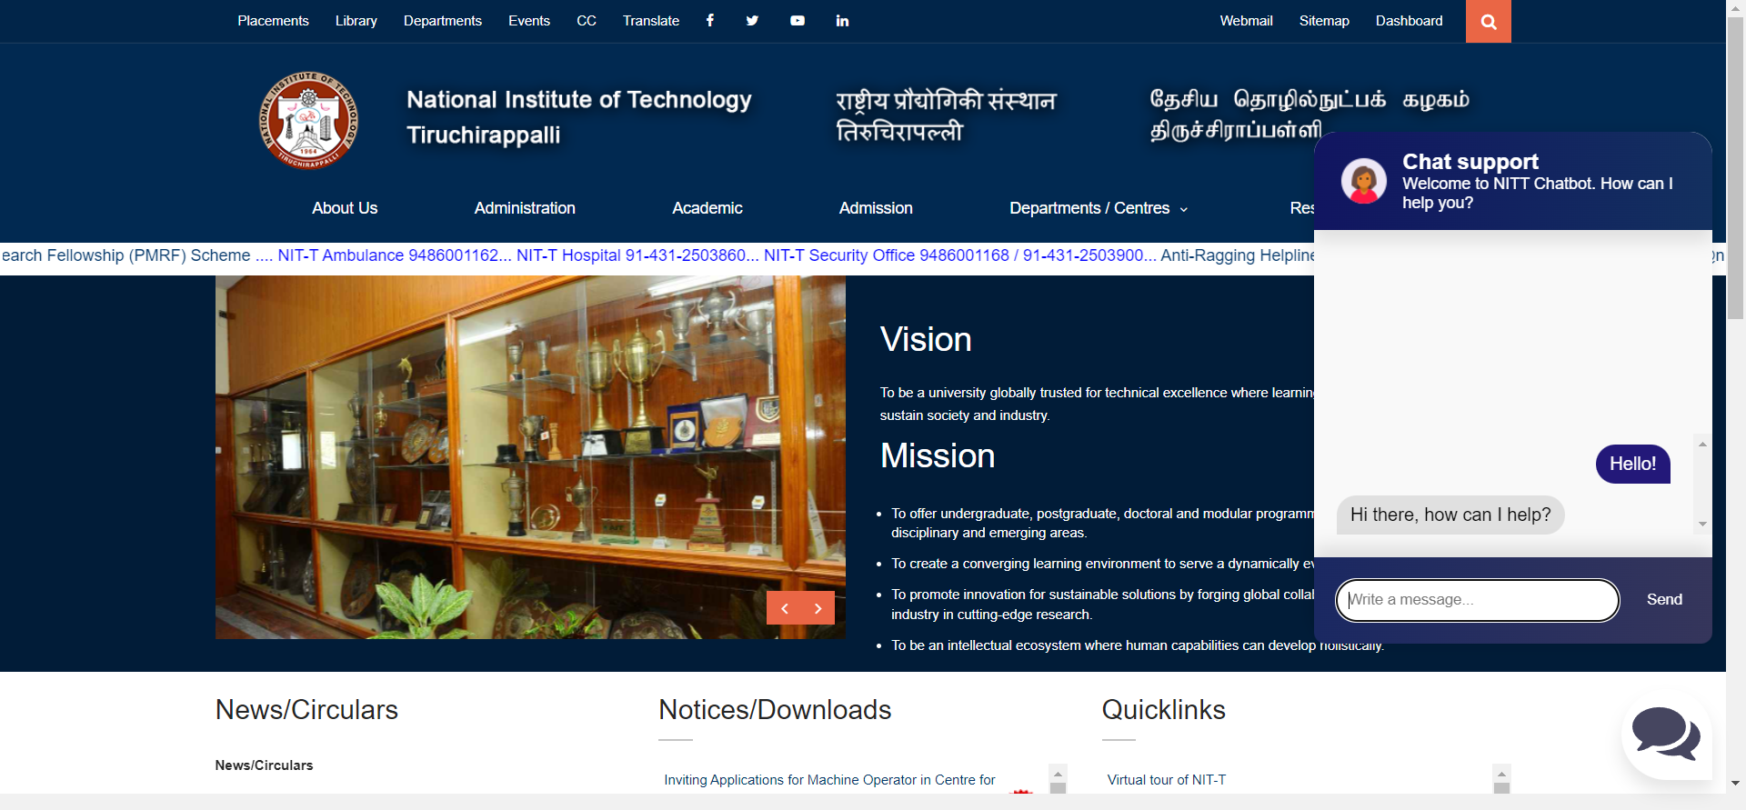
Chatbot Screenshot
Institute Website with Chatbot (Screenshot)

Slide 4
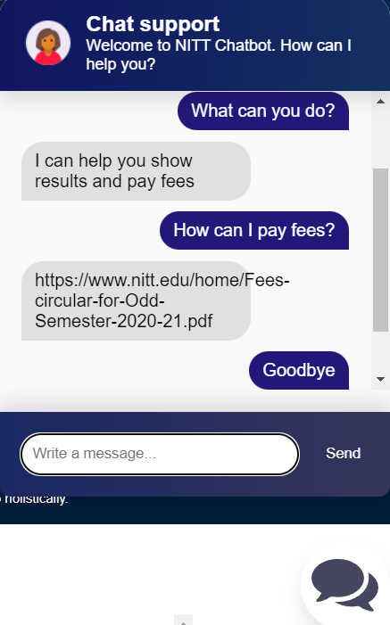
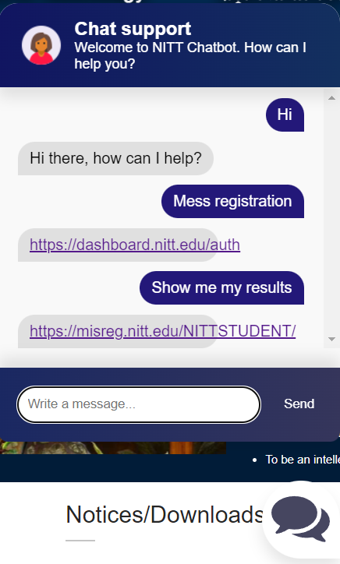
Chatbot OUTput
Chatbot Screenshot

Slide 5
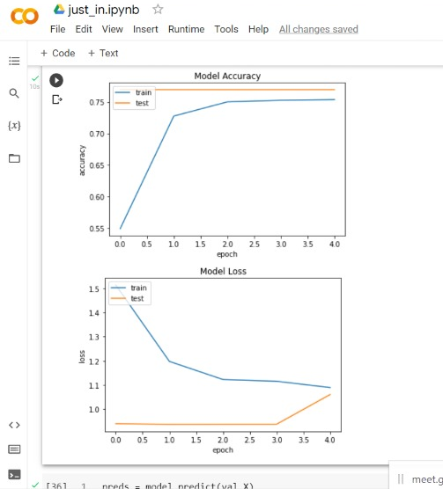
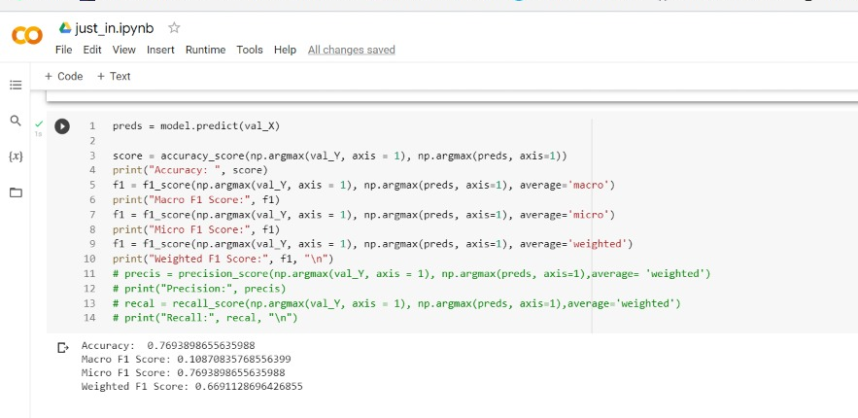
Screen Shots
Simple RNN:

Slide 6
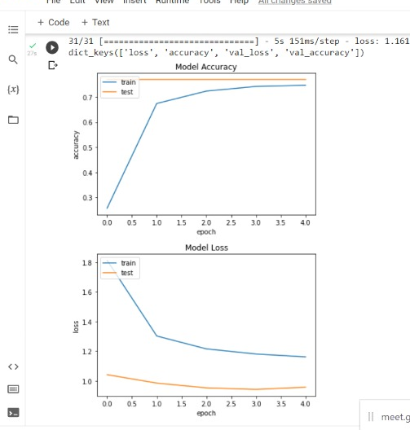
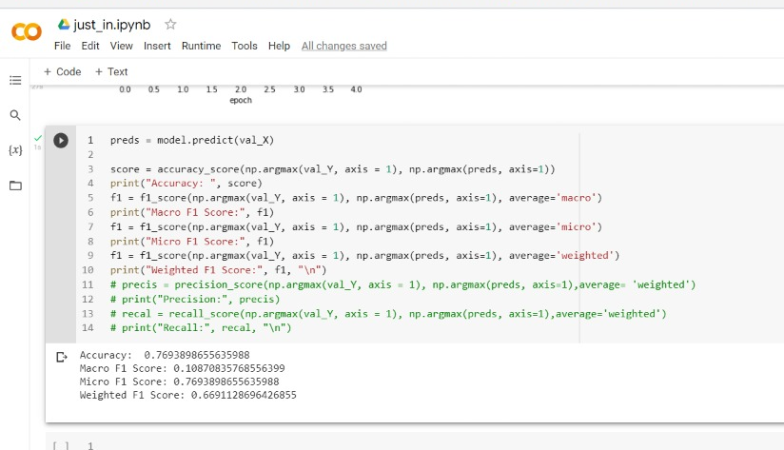
Screen Shots
GRU:

Slide 7
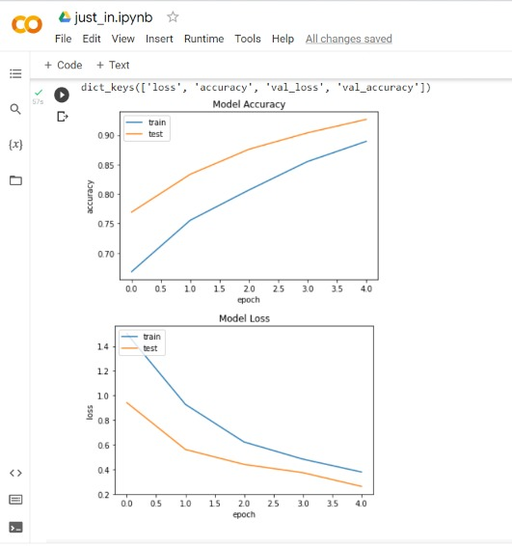
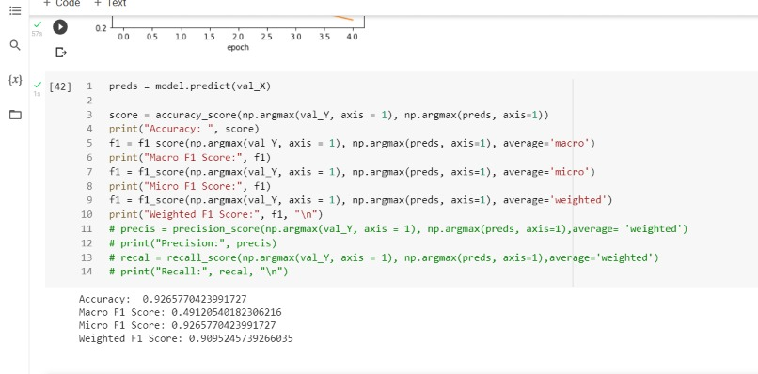
Screen Shots
BiLSTM:

Slide 8
Comparison of Different MOdels

Slide 9
Evaluation Metrics TAble
Model | Accuracy | Macro F1 Score | Micro F1 Score | Weighted F1 Score
Simple RNN | 0.77 | 0.109 | 0.769 | 0.67
GRU | 0.78 | 0.11 | 0.78 | 0.683
Bi-LSTM | 0.925 | 0.456 | 0.925 | 0.91
Naive Bayes | 0.97 | 0.92 | 0.97 | 0.97
Logistic Regression | 0.98 | 0.98 | 0.97 | 0.97
Linear SVM | 0.978 | 0.93 | 0.978 | 0.978
Poly SVM | 0.921 | 0.689 | 0.991 | 0.913
Rbf SVM | 0.959 | 0.799 | 0.959 | 0.954
Sigmoid SVM | 0.915 | 0.713 | 0.915 | 0.91
Table: Evaluation Metrics Table of different models for ATIS Dataset

Slide 10
Comparison With Existing Work
After reviewing other existing work,
We saw SVM worked the best for most of them
But For us Logistic Regression Model Worked the best and
The accuracy is High

Slide 11
Status of Thesis
Introduction:
Motivation, Basic Idea of Intent Classification & Chatbot, Objectives, Organisation of the report
1
Literature Review :
Literature Survey and Gaps identified
2
Implementation Details:
Algorithm, block diagrams, implementation
details , chatbot development
3
Dataset,
Results and Analysis:
Dataset, evaluation metrics,
performance analysis of results
through graphs, tables and outputs
4
5
Summary, Conclusion and Future works
Done
Yet to be done

Slide 12
References
1.J. Schuurmans and F. Frasincar, (2020) "Intent Classification for Dialogue Utterances," in IEEE Intelligent Systems, vol. 35, no. 1, pp. 82- 88, https://doi.org/10.1109/MIS.2019.2954966 .
2.T. -Y. Chen, Y. -C. Chiu, N. Bi and R. T. -H. Tsai, (2021) "Multi-Modal Chatbot in Intelligent Manufacturing," in IEEE Access, vol. 9, pp. 82118- 82129 https://doi.org/10.1109/ACCESS.2021.3083518
3.A. Benayas, R. Hashempour, D. Rumble, S. Jameel and R. C. De Amorim, (2021) "Unified Transformer Multi-Task Learning for Intent Classification With Entity Recognition," in IEEE Access, vol. 9, pp. 147306-147314, https://doi.org/10.1109/ACCESS.2021.3124268
4.T. -Y. Chen, Y. -C. Chiu, N. Bi and R. T. -H. Tsai, (2021) "Multi-Modal Chatbot in Intelligent Manufacturing," in IEEE Access, vol. 9, pp. 82118-82129, 2021, https://doi.org/10.1109/ACCESS.2021.3083518
5.M. Kumar, V. Kumar, H. Glaude, C. de Lichy, A. Alok and R. Gupta(2021) "PROTODA: EFFICIENT TRANSFER LEARNING FOR FEW-SHOT INTENT CLASSIFICATION" in IEEE https://doi.org/10.1109/SLT48900.2021
6.Zixian Feng, Caihai Zhu, Weihan, Zhang, Zhigang Chen, Wanxiang Che, Minlie Huang, Linlin Li (2021), "An Evaluation of Chinese Human-Computer Dialogue Technology" MIT Press Direct Data Intelligence (2021) 3 (2): 274–286, https://doi.org/10.1162/dint_a_00090
7.Tulika Saha, Dhawal Gupta, Sriparna Saha, and Pushpak Bhattacharyya (2021) “A Unified Dialogue Management Strategy for Multi-intent Dialogue Conversations in Multiple Languages” in ACM Trans. Asian Low-Resour. Lang. Inf. Process, Vol - 20, 6, Article 99 (November 2021), 22 pages. https://doi.org/10.1145/3461763
Our Code: https://colab.research.google.com/drive/1oDH_HWDDg_nmSm4G8iyMjyeHdImf13y-?usp=sharing&pli=1#scrollTo=XRFKXzek7Qsf

